Slide 1

EVENT MANAGEMENT USING FACIAL RECOGNITION
Presented By:
- 03 Anmol Choudhary

Slide 2
Introduction Facial Recognition :
A facial recognition system is a technology capable of matching a human face from a digital image or a video frame against a database of faces.
Facial recognition technology is a biometric software that mathematically stores an individual’s facial features.
This allows the technology to identify a person in live video or digital images without any other information.

Slide 3
Abstract:
Facial recognition technology is a biometric software that mathematically stores an individual’s facial features.
Event Check-in : Leave registration booths, barcodes, and name searching in the past. Instead, let the faces of attendees do the work. We can now use facial recognition technology to identify and register attendees at our event. Not only do self-check-in booths save our labour costs, the check-in is actually more secure.
Attendee’s Experience : People’s facial expressions can convey and reflect their emotions, like happiness, excitement, surprise, sadness, and boredom. Instead of waiting until the end of your event to receive feedback, you can use facial recognition technology to gain accurate, live feedback without bothering attendees.

Slide 4

Literature survey :
Journal Paper
A Counterpart Approach to Attendance and Feedback System using Machine Learning Techniques
Automated Attendance System Using Face Recognition
Student Attendance System Using Iris Detection

Slide 5
Existing / past systems :
Only have attendance system.
No real time tracking.
No real time feedback.

Slide 6

Problem Statement :
To generate efficient event management system as there is no management system with real time feedback.
To enhance event and attendee experience using AI and machine learning tools

Slide 7

AIM :
To generate an efficient software for event management which will provide real time feedback.

Slide 8

How can facial recognition technology be used in events?
Event Check-in
Attendee’s Experience

Slide 9
Facial Recognition :
Facial recognition is the process of identifying or verifying the identity of a person using their face.
Facial recognition technology is a biometric software that mathematically stores an individual’s facial features.
This allows the technology to identify a person in live video or digital images without any other information.

Slide 10
Algorithm (Haar Cascades):
Object Detection using Haar feature-based cascade classifiers is an effective object detection method proposed by Paul Viola and Michael Jones in their paper, “Rapid Object Detection using a Boosted Cascade of Simple Features” in 2001.
It is a machine learning based approach where a cascade function is trained from a lot of positive and negative images.
Initially, the algorithm needs a lot of positive images (images of faces) and negative images (images without faces) to train the classifier. Then we need to extract features from it.

Slide 11
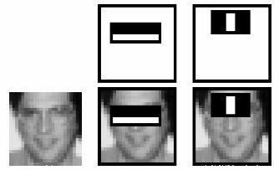
Four Stages Of Haar Cascade Algorithm:
Haar Feature Selection
Creating Integral Images
Adaboost Training
Cascading Classifiers

Slide 12
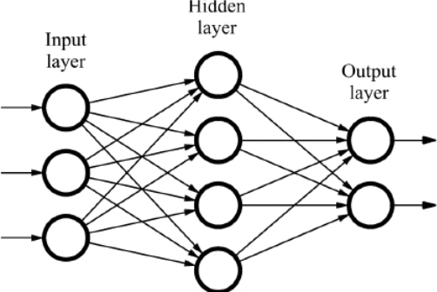
Convolutional Neural Networks :
CNN
A kind of neural network where the input is image
Contains less fully connectivity between neurons
CNN layers
Convolutional layer
Pooling layer
Fully connected layer

Slide 13
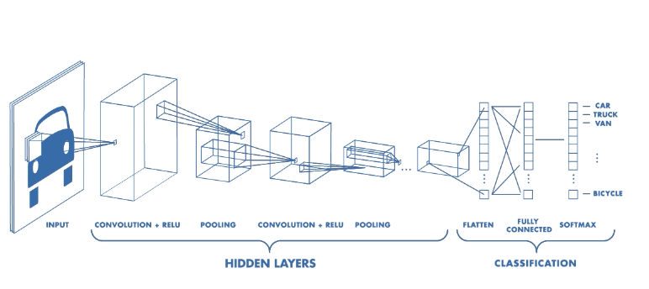
Convolutional Neural Networks :

Slide 14
Face Recognition library :
Recognize and manipulate faces from Python or from the command line with the world’s simplest face recognition library.
Features:
Find faces in pictures
Find and manipulate facial features in pictures
Identify faces in pictures

Slide 15
Index :
Database Design
Entities & Responsibilities
Practical Implementation
Tech Stack

Slide 16
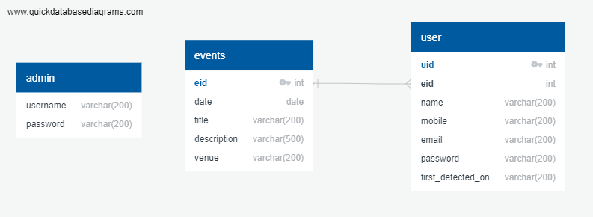
Database Design :

Slide 17



Entities & Responsibilities :
Entity Names
Admin
Event
User

Slide 18
Admin :
Responsibilities
Create an Event
Edit Event Information
Monitor Events & Users
Generate Attendance Report

Slide 19
Events :
Responsibilities
Displaying Updated list of events
Option for registering for an event

Slide 20
User :
View information about registered event
Edit Profile Information
Upload Profile Pictures

Slide 21
Practical Implementation :
Implementation of project

Slide 22
Tech Stack :
Html, CSS, Bootstrap
JavaScript, jQuery
Ajax
PHP
Flask
MySQL

Slide 23

Feedback system GUI :
Django :
Django's primary goal is to ease the creation of complex, database-driven websites.
Django is a Python-based free and open-source web framework that follows the model-template-view (MVC) architectural pattern.
Django is easy to integrate with python ML, AI implementation.

Slide 24
Emotion recognition :
One of the important ways humans display emotions is through facial expressions.
Facial expression recognition is one of the most powerful, natural and immediate means for human beings to communicate their emotions and intensions.
Emotion recognition is the process of identifying human emotion.

Slide 25
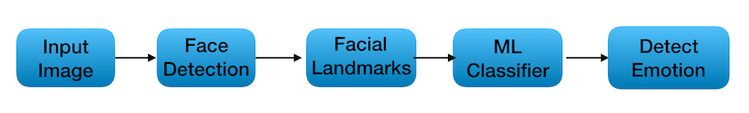
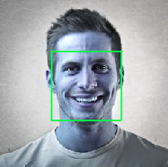
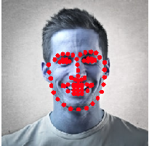
Emotion recognition working :

Slide 26
Dataset we used for emotion detection :
Fer2013
The data consists of 48x48 pixel grayscale images of faces.
The faces have been automatically registered so that the face is more or less centered and occupies about the same amount of space in each image.
The training set consists of 28,709 examples.

Slide 27
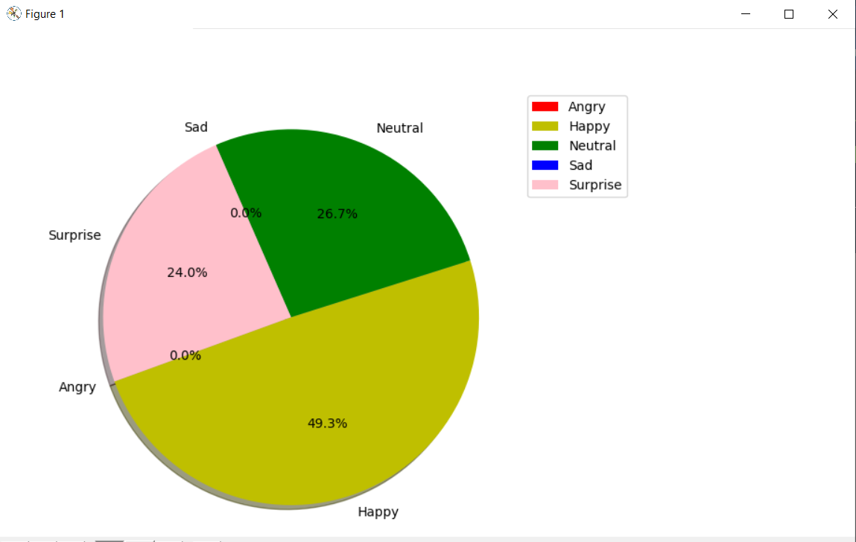
Feedback system :
Angry, Happy, Sad, Neutral, Surprise
Count (Happy + Neutral + Surprise) >= ( Angry + Sad)
“Event was successful”
Count (Happy + Neutral + Surprise) < ( Angry + Sad)
“Event was unsuccessful”

Slide 28
Limitation and Scope :
Limitations
Facial recognition is constrained by poor image quality.
The accuracy of facial recognition can be hampered by different face angles.
Facial recognition technology can be limited by data processing and storage.
Scope for future development
Integration of criminal record and social media account with our system.
Sensor implementation for making facial recognition more efficient and faster.
Feedback of individual attendees.

Slide 29
Conclusion :
Smart event management system is designed to solve the issues of existing manual systems. We have used face recognition concept to mark the attendance of attendee and make the system better. The system performs satisfactory in different poses and variations.
Along with attendance system, its also provide feedback.

Slide 30
Reference :
6.1 Journal Paper
A Counterpart Approach to Attendance and Feedback System using Machine Learning Techniques
Automated Attendance System Using Face Recognition
Student Attendance System Using Iris Detection
6.2 Courses
Machine Learning-Stanford University Andrew Ng
6.3 Weblink
https://opencv-python-tutroals.readthedocs.io/en/latest/py_tutorials/py_objdetect/py_face_detection/py_face_detection.html
https://docs.python.org/3/
https://www.wikipedia.org/

Slide 31
THANK YOU

